Slide 1
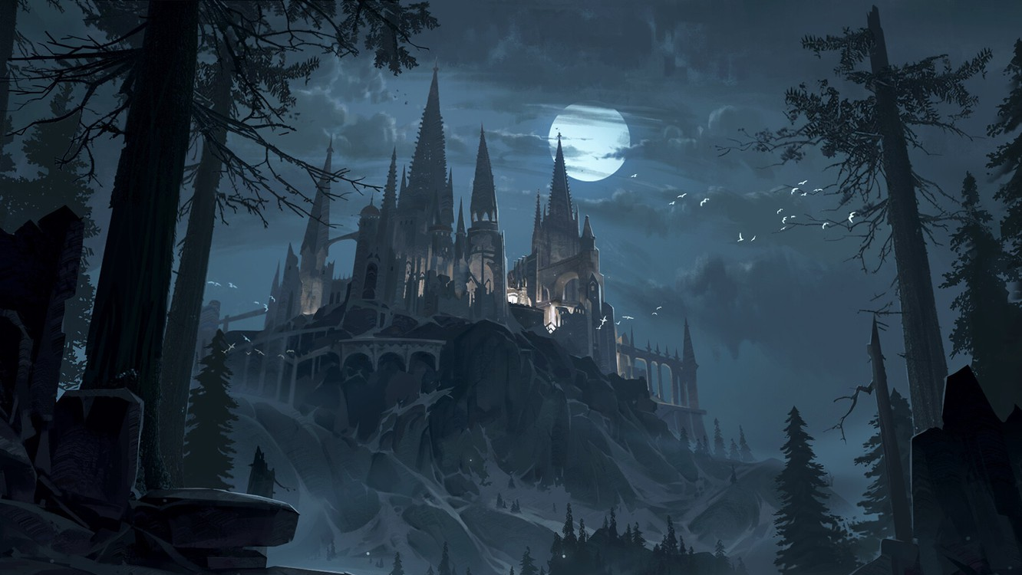
The Curse of The Magic Forest
Art by Nyankosensei, anime.goodfon.com

Slide 2
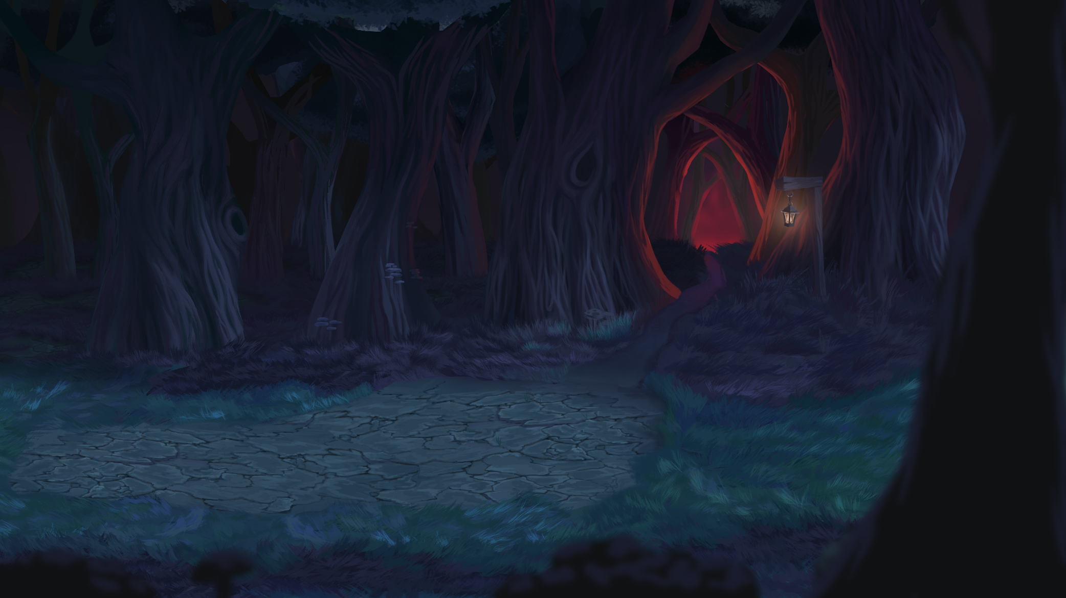
Content
Overview
Backstory
Gameplay
Main and side goals
Environment- Village map
Demo village map
Main Characters
Player Control Flow Chart
Enemy, NPC Control Flow Chart
Enemy Boss Control Flow Chart
Controls
Antagonists
User Interface Menu for new players
UI for returning players
Options UI
Asset List
Research
Development plan/timeline
Justification and Evaluation
Justification: Marketing Analysis
Audience and Revenue
Legal and Ethical issues
References
Art by Drykkur on indiedb.com

Slide 3
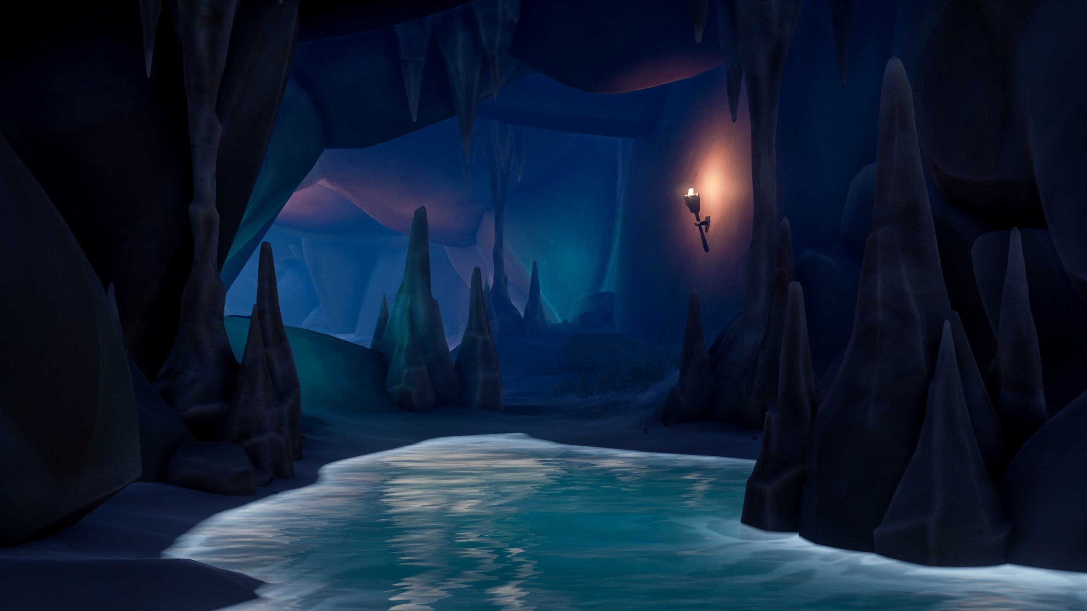
Overview
Title: The Curse of The Magic Forest
Genre(s): Action, Role-playing game, Adventure
Platform(s): Microsoft Windows
Audience: 12+
Synopsis: After the invasion of the Evil Alvan, you are tasked to free your homeland and bring back the Heart Of The Forest. This will not be easy because the armies of evil will try to stop you at all cost.
Art from Teahub.com

Slide 4
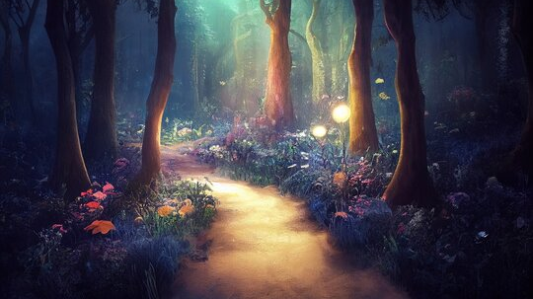
Back story
Once upon a time The Magic Forest was a place filled with life and joy. But one day, everything changed when suddenly the Evil Alvan invaded the peaceful forest, taking their most precious relic- The Heart of the Forest, a bright and powerful green gem that gives life and makes magic possible in the forest. Without this gem, the forest will not survive long and its citizens will become wild animals. The adventure begins when Hip and Hop, the apprentices take on the challenge to bring back The Heart of the Forest and defeat the evil plans of the Mighty Alvan. It will not be an easy task because the armies of evil will be getting in their way. However, our heroes might encounter allies as they progress further on their adventure.
Art from (Adobe Stock, n.d.)

Slide 5
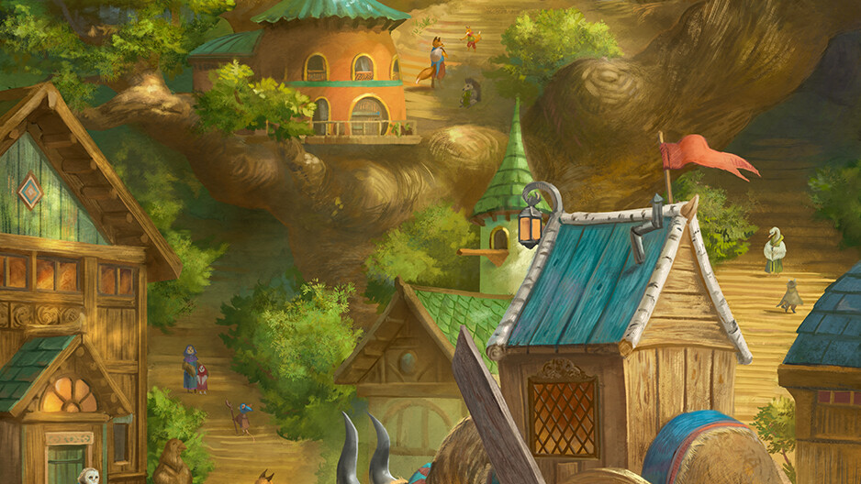
Gameplay
The game will be played by using your mouse and keyboard. By using specific keys, you will be able to move your character: jump; crouch, collect items and interact with NPCs. By using your mouse, you will be able to attack and create special combos. The game itself will be fast action which will test the players’ abilities to make quick decisions and improve their gaming skills. The decisions that the players take during the course of the game, will help shape the outcome, because every choice matters. The story of the game is created to take approximately 4 hours.
Art by Julia Metzger on Artstation

Slide 6
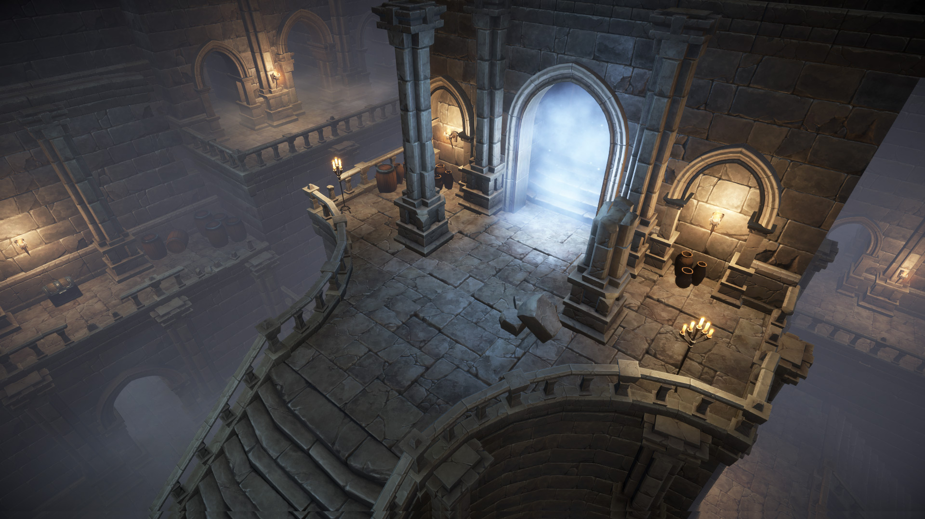
Main and side goals
Help our main character/s, Hip&Hop, to save his homeland, The magical Forest and defeat the evil Alvan.
Escape dungeons
Do quests and gain XP to level up your stats.
Make new friendships
Improve your combat skills
Image by Mana Station in Unity Assets

Slide 7
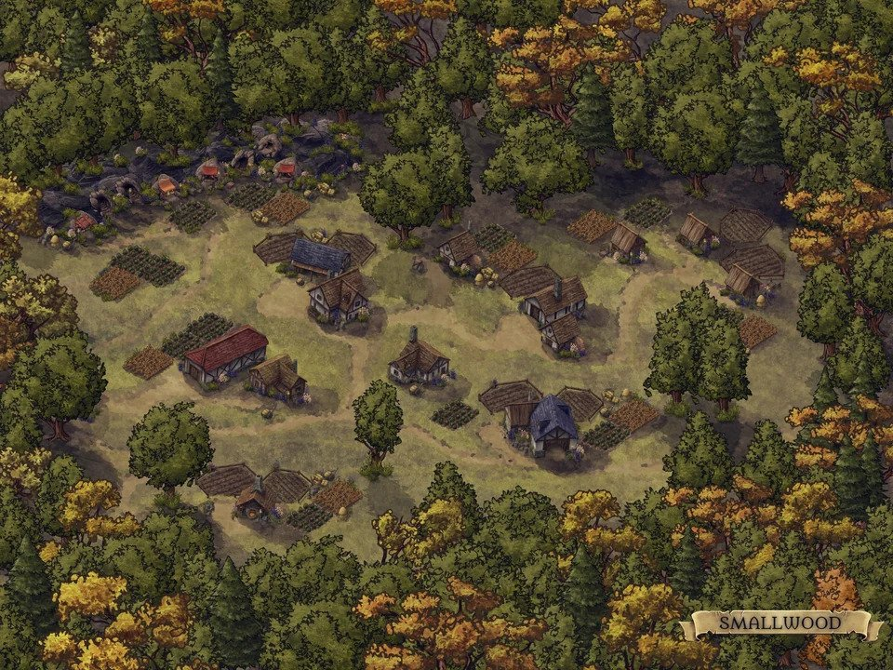
Environment Village map
This drawing is taken from Inkarnate (reddit, 2021). It represents the village from where the main characters will start their adventure. Unfortunately, the armies of skeletons have decided to attack the poor villagers and take over the area. The player must protect the innocent and defeat the skeleton armies before taking over the next task of the game. The skeleton army would patrol in random spawns of the village and would attack if the player is in sight.
Art by Oshutter in reddit

Slide 8
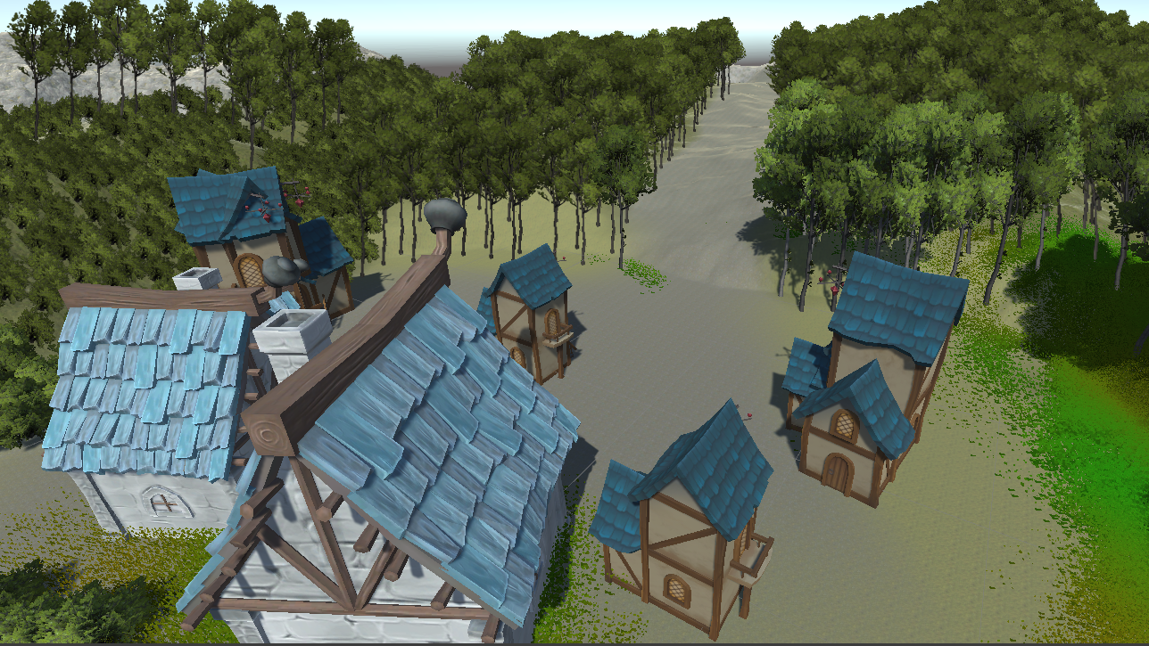
Demo of the village map

Slide 9
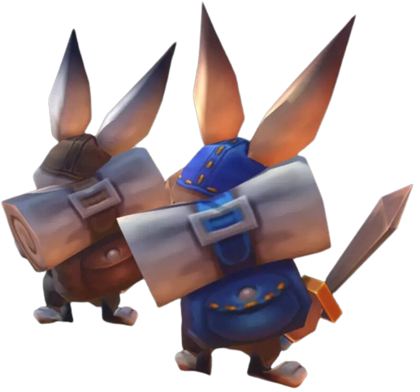
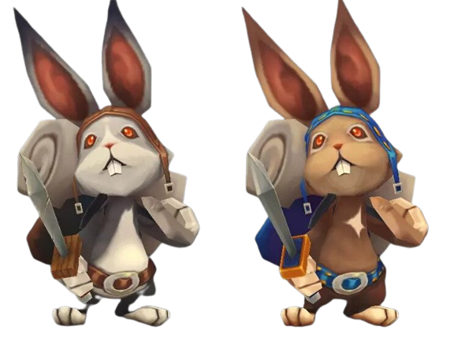
Environment Main Character/s
The characters on the images are Hip(silver bunny) and Hop(brown bunny), the main characters of the game that will be controlled by the player/s. Their main goal is to restore the Forest from Alvan’s curse and return the Heart of the Forest back to the village. However, the characters must encounter Alvan’s army of minions to get to his lair, the castle. By lore, Hip&Hop must cleanse the gem from the evil magic before them and the whole village become ordinary animals.
Characters by Hit in unity asset store (assetstore.unity.com, n.d.)

Slide 10
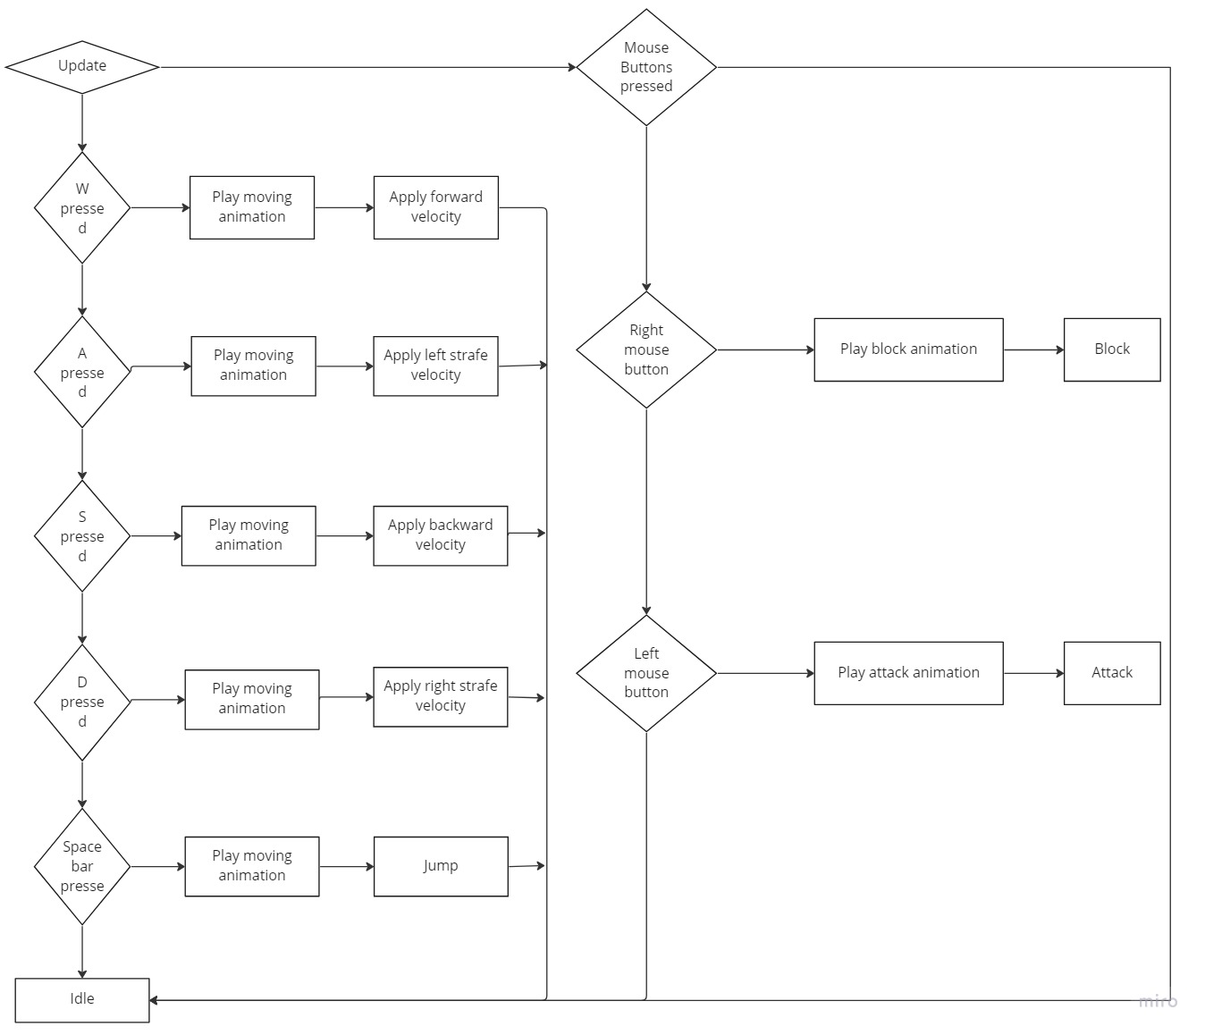
Player controller

Slide 11
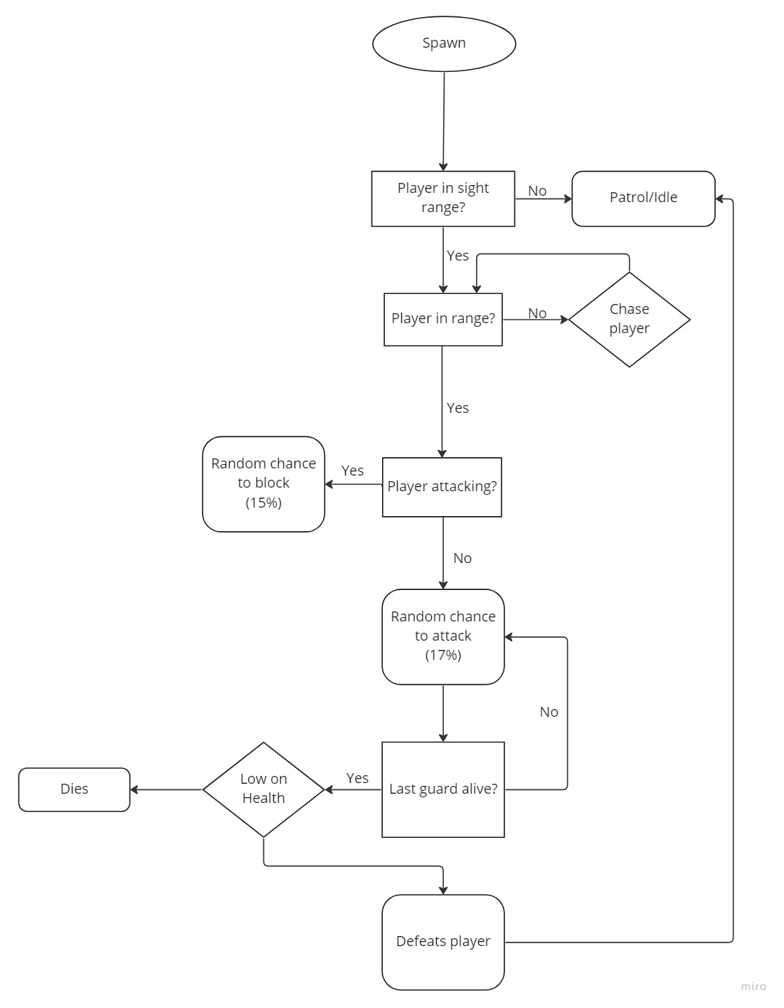
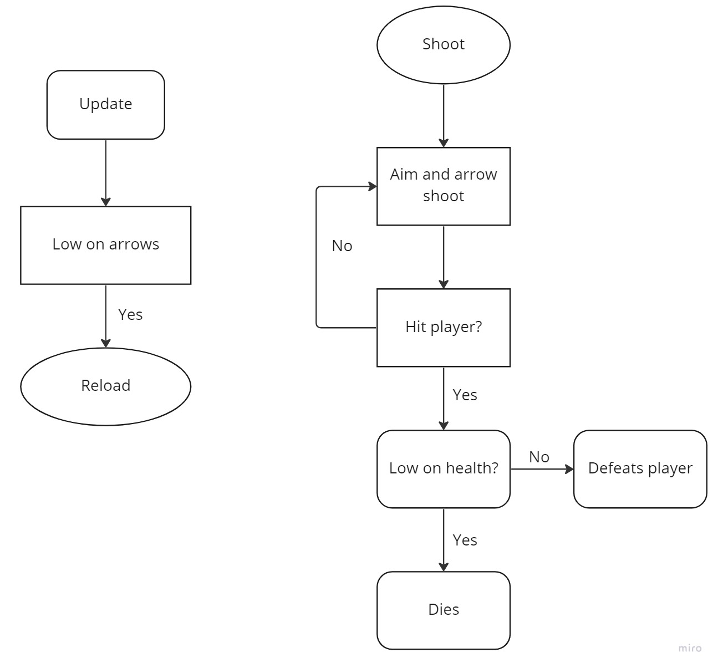
Enemy AI Controller

Slide 12
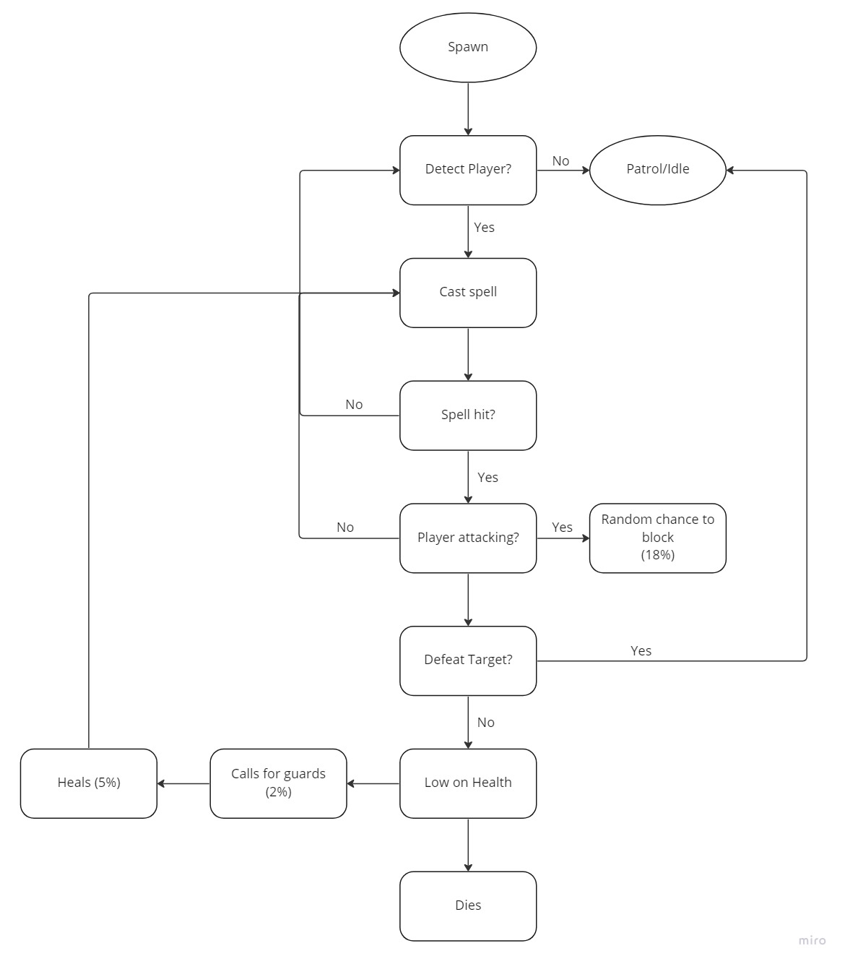
Enemy Boss AI Controller

Slide 13
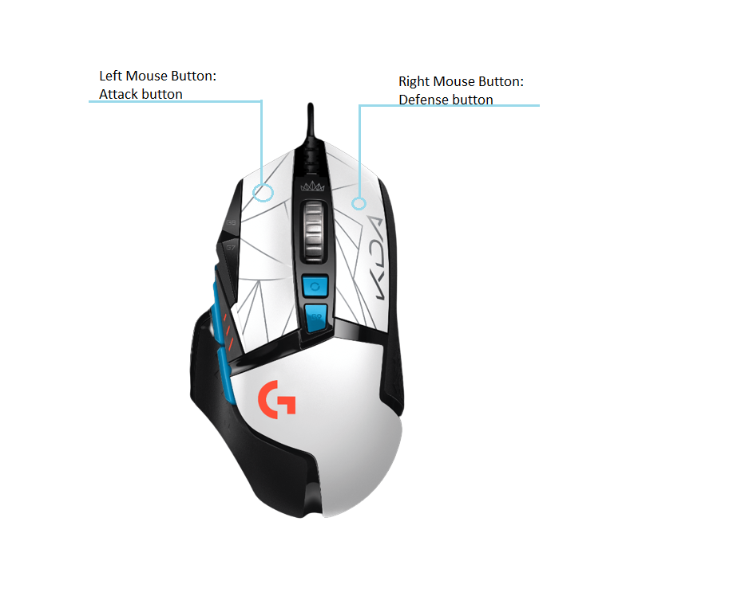
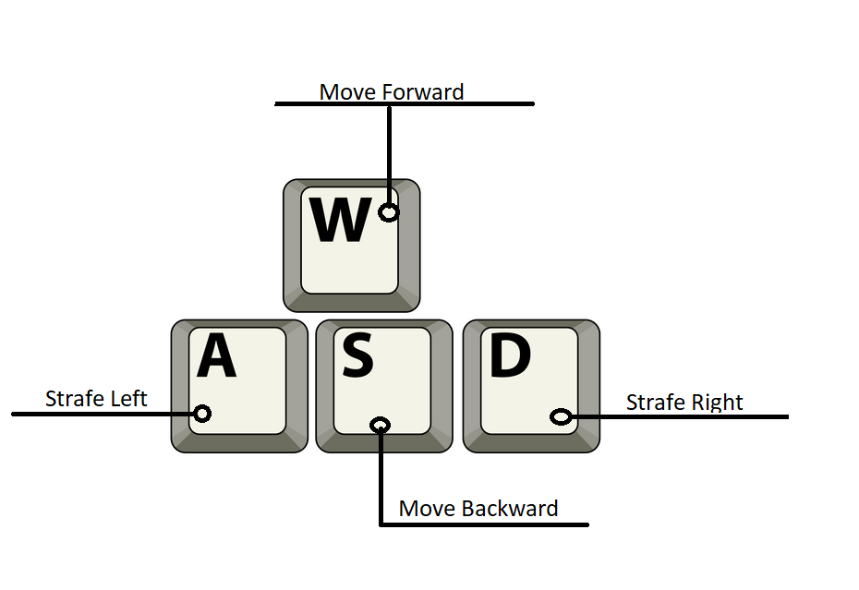

Controls
Jump

Slide 14
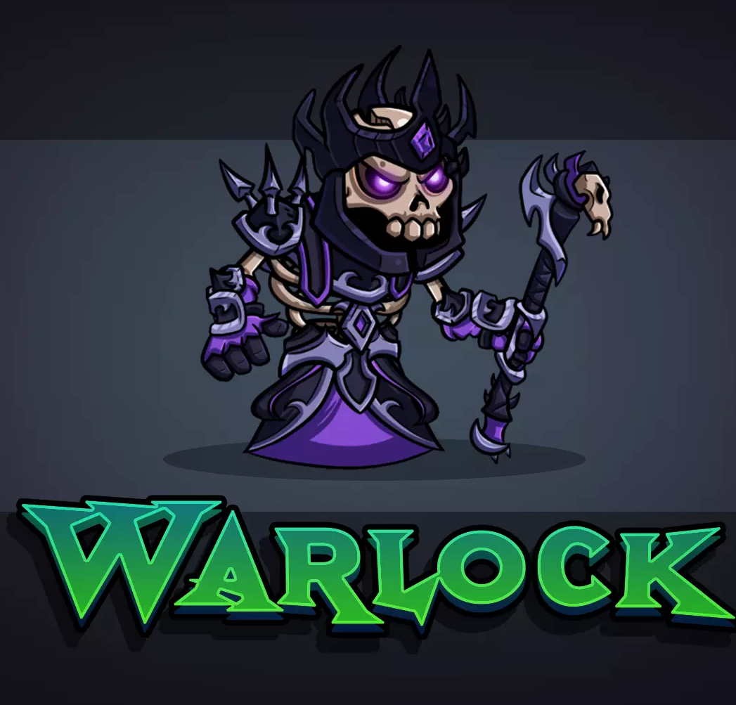
Antagonists
Art and Design by: Art by Kandles in Unity.
(assetstore.unity.com, n.d.)
Name: Alvan/ The Evil Alvan
Alias: Skeleton Army; Dog Guards
Species: Undead Warlock
Age: several centuries
Size: 120cm, small
Appearance:
Wearing long purple robe
His powers come from his staff and crown.
Features:
The most powerful being in the game, aka the boss.
He can use his powers to
attack the players and deals more damage
than the skeleton army and the dog guards
Will be able to block attacks.

Slide 15
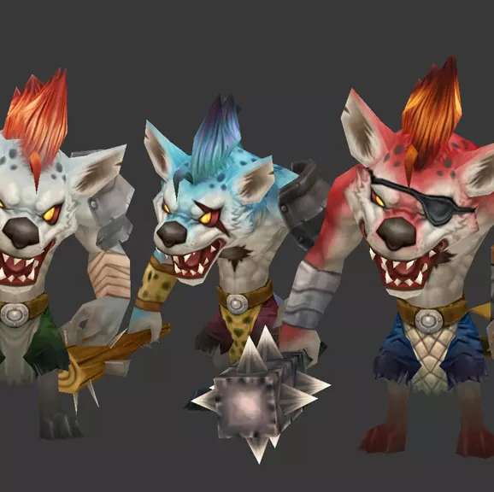
Antagonists
Art and Design by: Hit in Unity
(assetstore.unity.com, n.d.)
Alias: Skeleton army, Alvan/ The Evil Alvan
Species: Animals
Age: unknown
Size: 116cm
Appearance: Covered in a little body armor and scars
furry warriors
Features: Attack with maces
Work in a group
Can avoid attacks

Slide 16
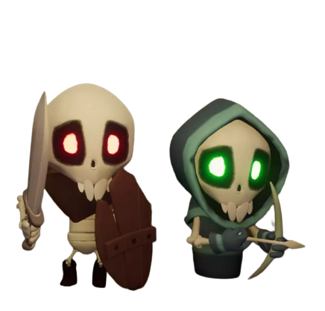
Antagonists
Art and Design by: Matheus Antonio in Unity
(assetstore.unity.com, n.d.)
Alias: The Evil Alvan, Guard dogs
Species: Undead
Age: unknown
Size: 113cm
Appearance: Skeletons in body armor
Equipped with a sword or a bow with arrows
Features: Prefers to work in a group.
A little dumb and forget about their target quickly.

Slide 17
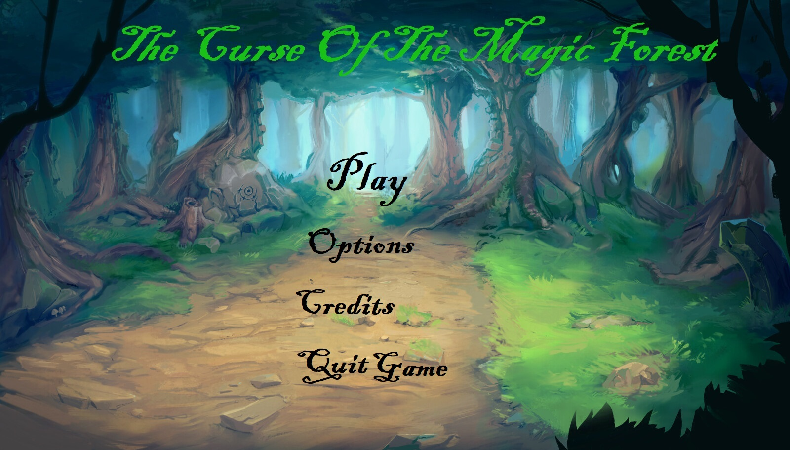
User Interface (UI) for new players
Art by: Marcos Álvarez on artstation.com

Slide 18
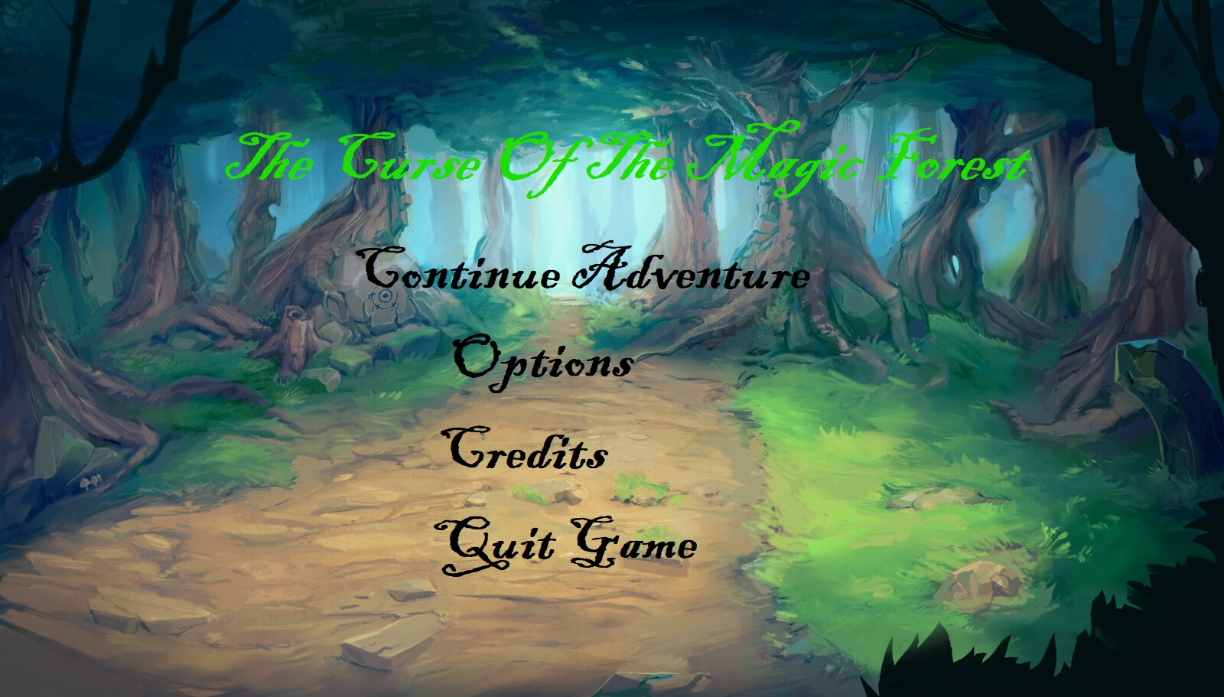
User Interface (UI) for returning players
Art by: Marcos Álvarez on artstation.com

Slide 19
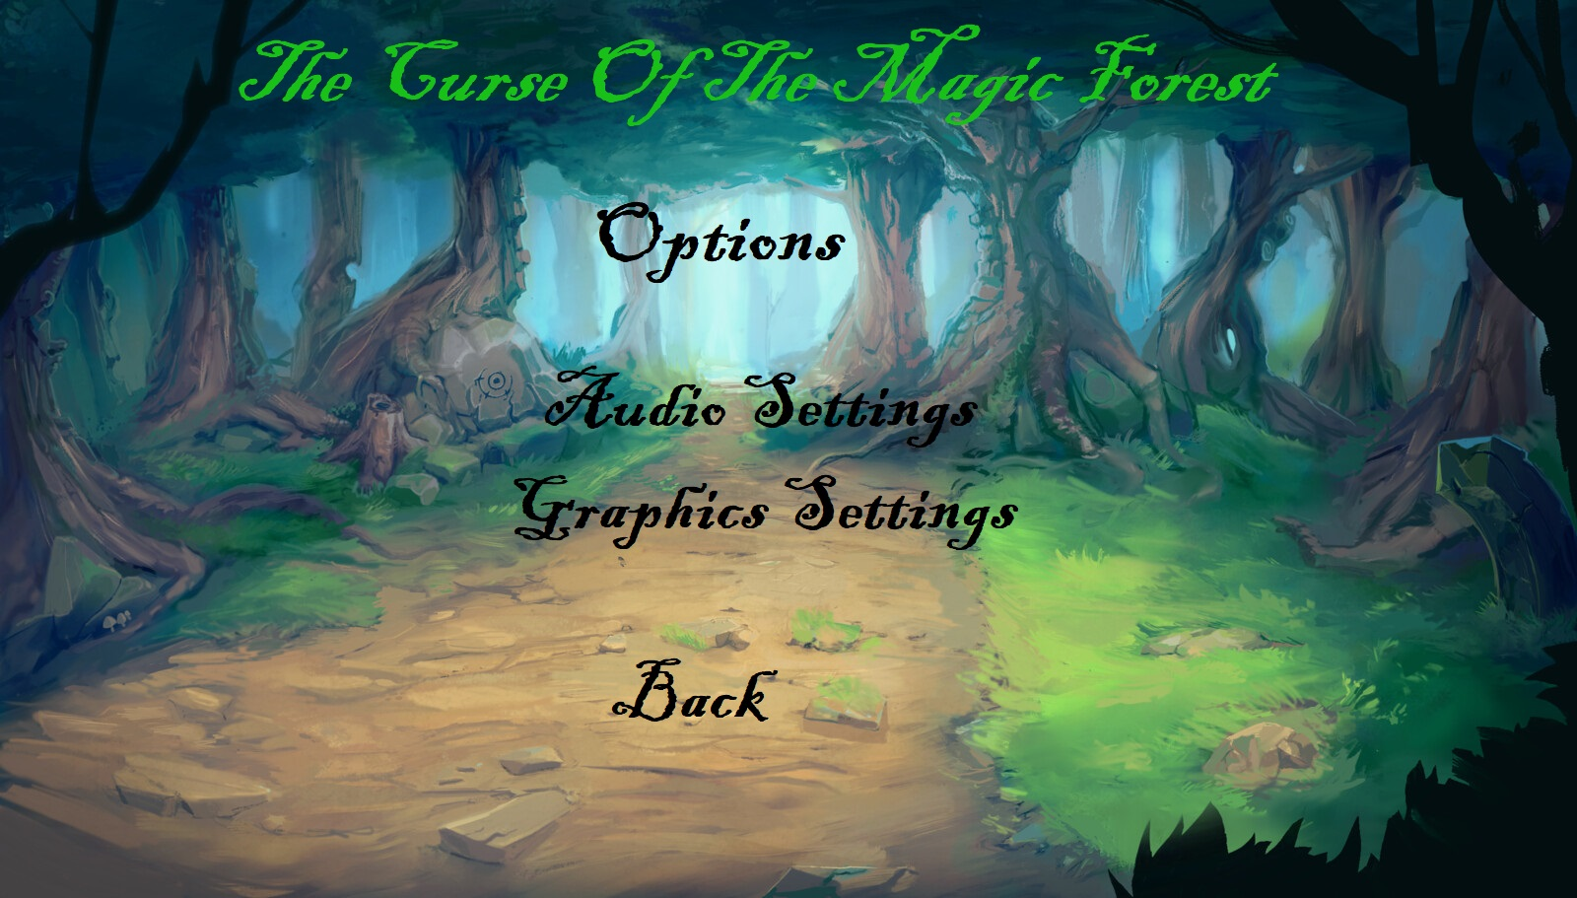
Options Interface
Art by: Marcos Álvarez on artstation.com

Slide 20

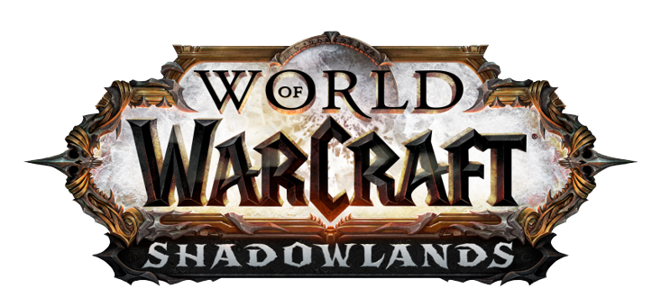
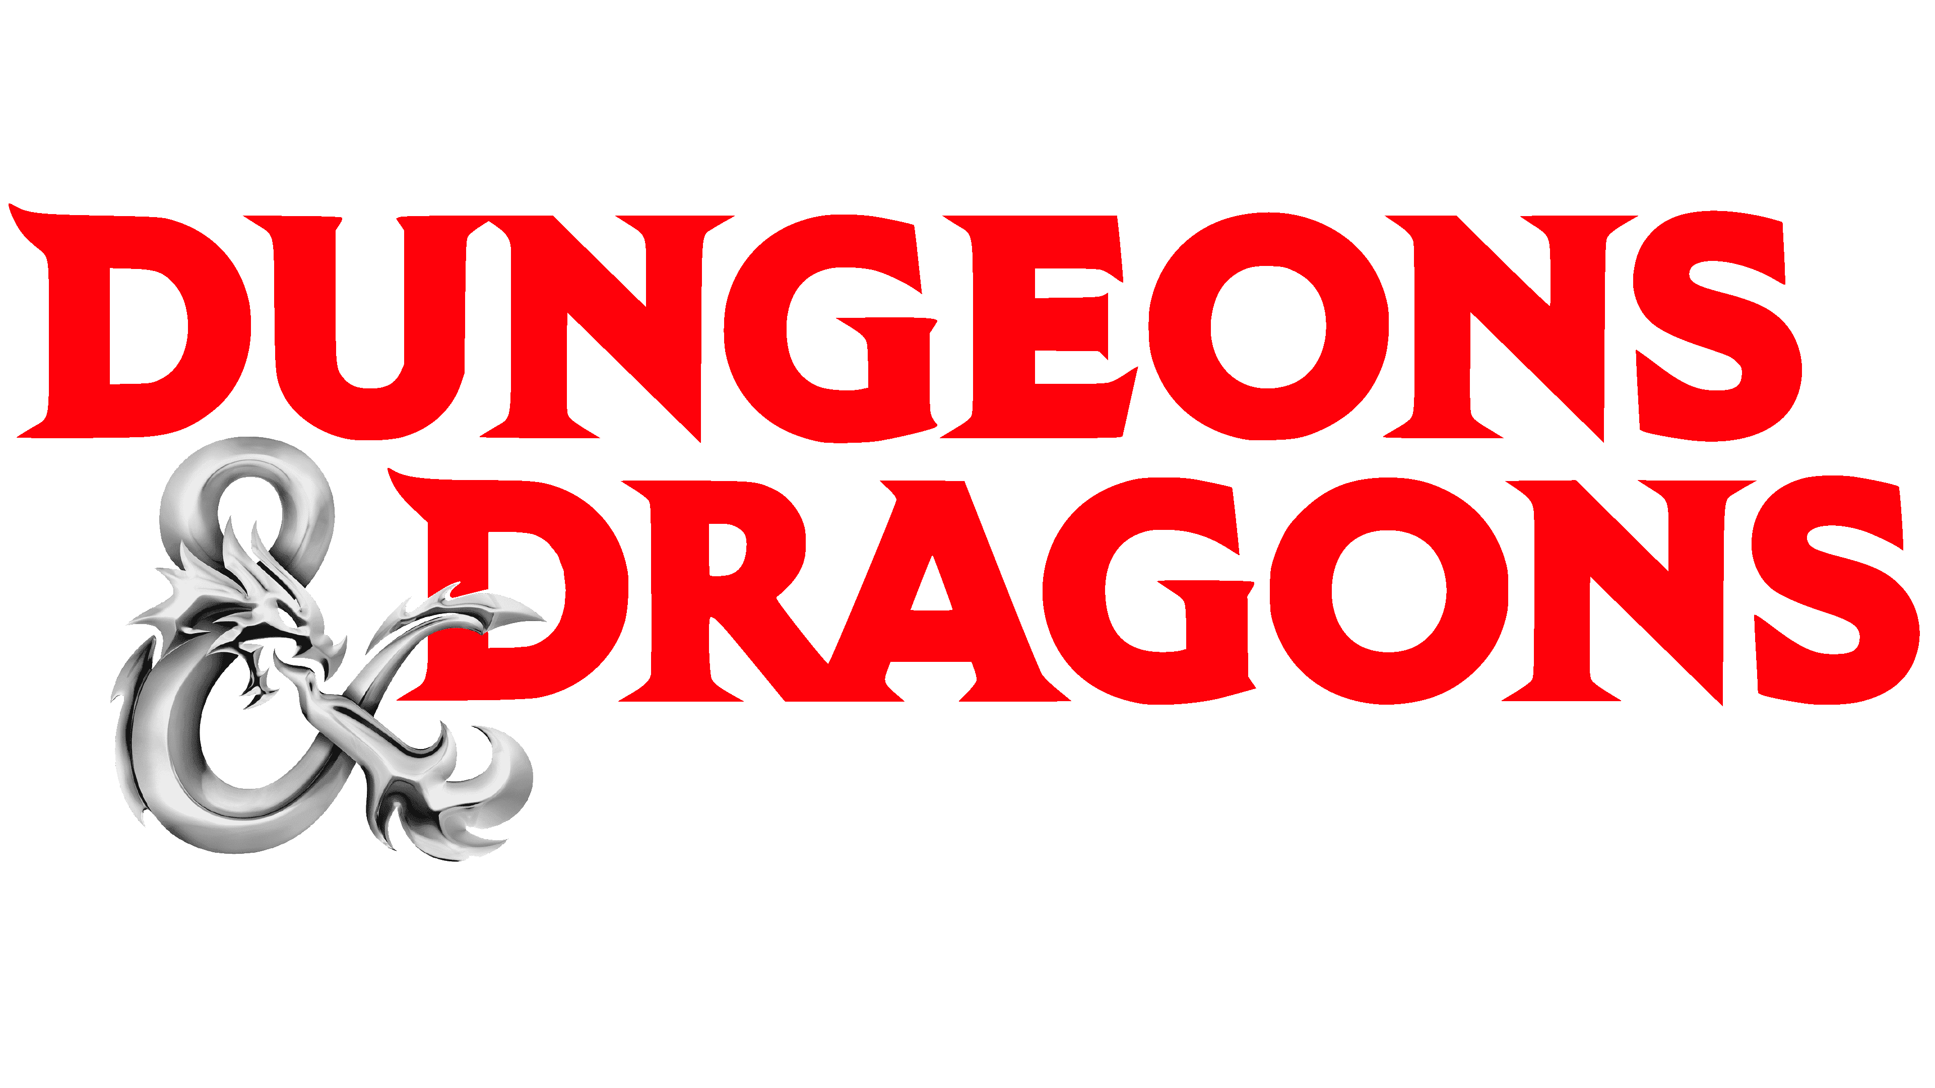
Research
Since the game will be about fairytail animals and dungeons involved, the main inspiration comes from these three games:
Genshin Impact
World Of Warcraft
Dungeons & Dragons

Slide 21
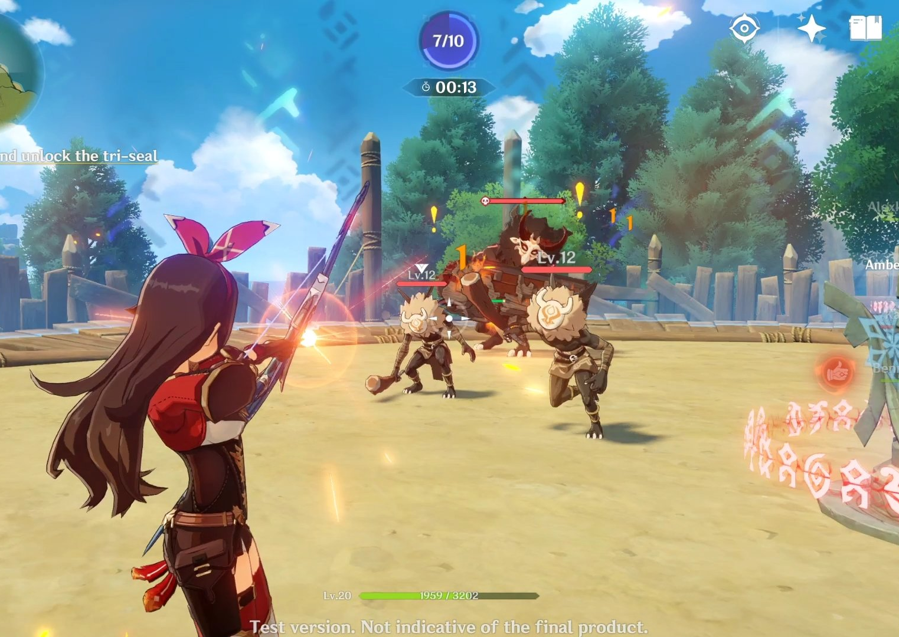
Research- Genshin Impact
Genshin Impact(genshin.hoyoverse.com, n.d.) by originally by miHoYo, later on transferred to hoyoverse is extremely popular game which inspired me to create a similar battling system for two reasons:
1. It is simple to understand and get the hand of the moves and combos.
2. It is quite entertaining and keeps the players interested throughout the story. What also gave me a hint of an idea is the third- person view, which I really enjoyed not only in this game but also in our second example.

Slide 22
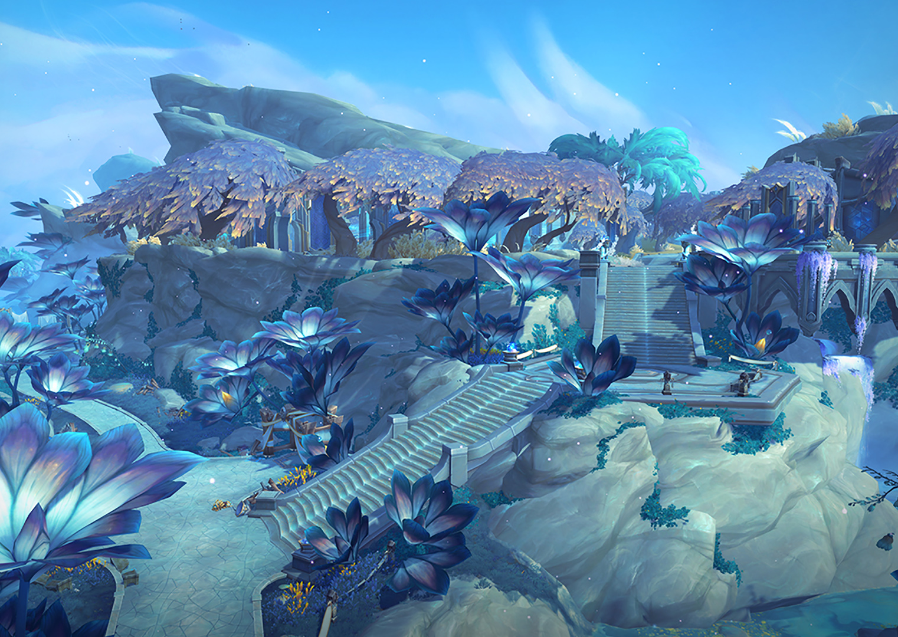
Research World Of Warcraft
What inspired element of role-playing was none other than one of the first classical MMORPGS – as how fans call it WoW (World of Warcraft, 2019). One of the many things that really stands out is how they module their surroundings and places around the world. The graphics are rustic which gives you the amazing feeling of getting into the story, especially in the latest expansions. Blizzard Ent. (Blizzard.com, 2019) also created some of the iconic dungeons, which helped me get an idea how to module in this genre.

Slide 23
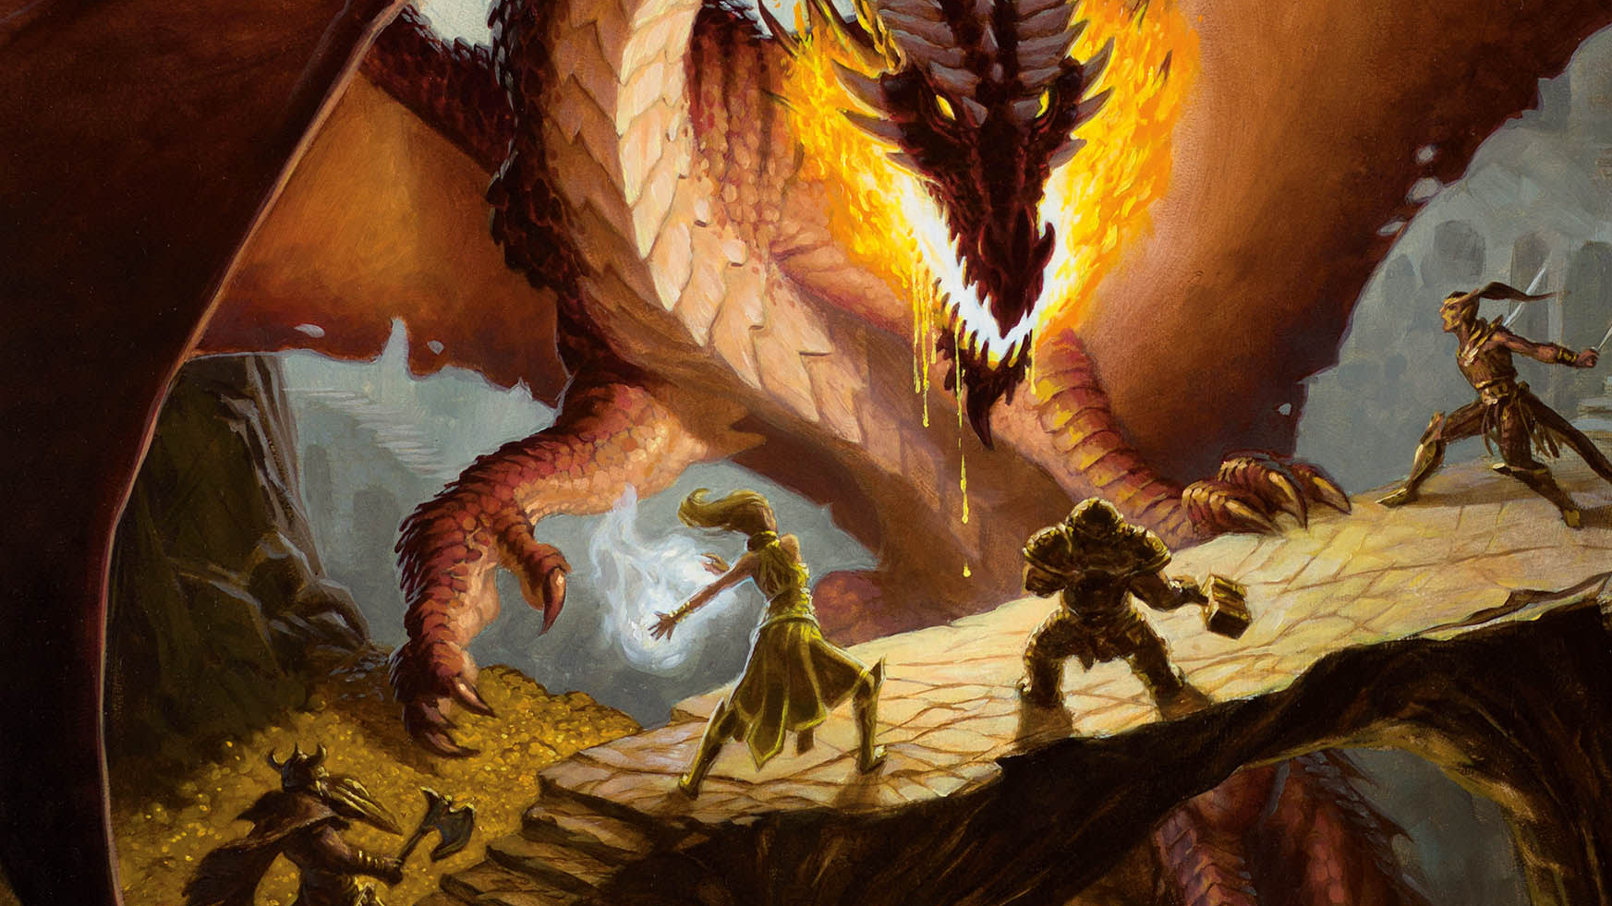
Research Dungeons & Dragons
Even though this is a mostly board game, some of its characteristics can be implemented, such as character design and story development, it helps you build your imagination, because you have to picture in your mind how the story and the battles go. Which is also perfect for creating custom characters. In DnD (Haeck, 2019) you can be whatever creature you wanted, and this is why I chose magical animals for my game.

Slide 24
Asset List
3D characters for Hip&Hop, skeletons, guard dogs and Allvan.
Attack animations for Hip&Hop, skeletons, guard dogs and Allvan.
Death animations for Hip&Hop, skeletons, guard dogs and Allvan.
Grass, tress, rocks, ground, village houses, Allvan castle, dungeon.
Sounds for attacking and/or getting hit, footsteps, boss music, forest sounds (birds chirping, etc), landing after jump, enemy or player death.

Slide 25
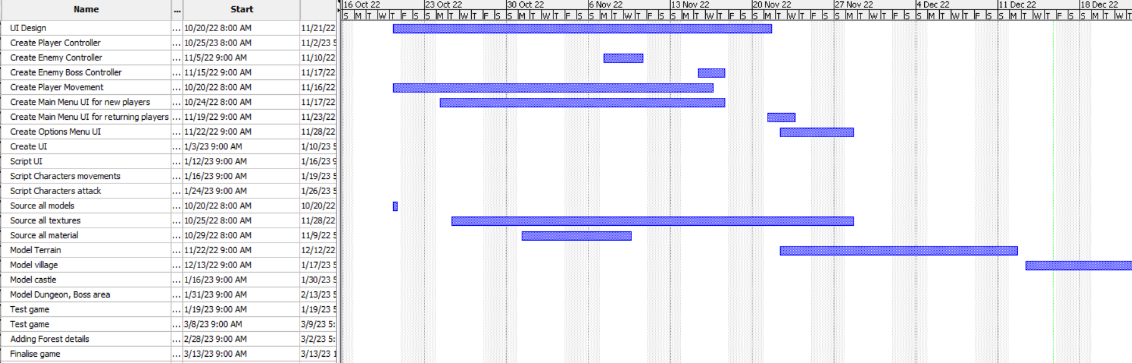
Development plan Timeline
This is a brief look how the work will be balanced during the two terms. The project is not that big so taking this amount of time should be more than enough. Although time could be more than needed, there could be more and new added features in the game.
Approximately working an hour or so a day. However, having days off on some Fridays and Sundays, also taking break on holidays.

Slide 26
Audience and Revenue
“The Curse Of The Magic Forest” is intended for audience over 12 years old. This adventure game is action-packed and will keep the player entertained while exploring the magical forest, battling with dangerous armies of undead skeletons and blood thirsty hounds. Games rated PEGI 12 may contain more detailed and realistic looking violence, which may not be appropriate for younger audience. There may be horror elements and combat that may include graphical violence. The game is aimed for the player to enjoy the gameplay while keeping up with the amazing story.
The unique selling point of the game is the game story and boss fight. For example, the player will feel a sense of justice and accomplishment when he is finally able to defeat the Evil Alvan and cleanse the power of the crystal gem.
The game will be available for purchase between £7.99 and £9.99, with no in-game purchases. The price is such, due to the fact, the game does not have much replay-ability value, as well as its short story which takes around 2-4 hours. For a minimal budget game, marketing on social media platforms can be an ideal solution to reach the target audience. For example, Instagram or Youtube advertisements for sponsored videos by using age location and interests.

Slide 27
Legal and Ethical issues
Facing legal issues during the release phase of the game is normal. This is why, preventive measures must be taken. For example, the assets used from unity to either build the game or bring the characters to life are all legally bought or free to use, thus do not fall under any illegal activity, in other words, to use the copyright content. There will be no in-game personal data collection and no account creation required. The Curse Of The Magic Forest will be published commercially to the public, meaning that the content of the game must be fully under the terms for CC BY or CC BY-SA licenses. Sounds and sound effects used will have a license to ensure they can freely be used in commercial projects. They will be sourced from the creative common archive.
In terms of Health and Safety in game, there might be content that could be disturbing to player base at risk. As well as people who are sensitive to bright lights and loud sound effects. Therefore, warning for those at risk, will be displayed before the game starts. The game will have a PEGI rating of 12 as the content of the game shows violence of slightly more graphic nature towards fantasy characters or non realistic violence towards animal-like characters. Mild bad language used. Even though the sounds play a part of the project, the game will implement visual cues so the sound is not critical to finishing the game. This will make The Curse Of The Magic Forest accessible for those with hearing disabilities.

Slide 28
Technologies Justification
This project is built by using Unity Game Engine (Unity Technologies, 2020). Using Unity’s inbuild NavMesh agent, we created a smooth movement design for the player agent and NPCs. The process of creating level geometry will be achieved by NavMesh baking from which it will render meshes and terrains of all game objects and mark them on the navigation static. Therefore, creating a walkable surface for the player to move on.
The game uses a third- person camera view and all the player can see is their character and a bit of their surroundings. Furthermore, players can interact with local environments, as well as jump on flat surfaces. Unity physics will be applied for simulation of 3D movement, mass, gravity and in-game collision. Components, such as character controllers, colliders and rigid bodies. Unity allows the implementation of packages that extend the functionality of the game engine. For example, the Main camera which is an orbital camera for the character controller. Unity’s animation features include retargetable animations, full control of animation weights, sophisticated machine hierarchies and transitions and many more. Unity UI will be used for developing user interfaces for the game and customizing position, arrangement and style of user interfaces. Unity lighting will help to achieve the atmospheric lighting with different colours and intensity. Shaders and particle system will be used to achieve visual effects, for example, fighting animations, death animations and more.

Slide 29
References
Adobe Stock. (n.d.). Enchanted Forest At Night Images – Browse 10,679 Stock Photos, Vectors, and Video. [online] Available at: https://stock.adobe.com/uk/search?k=enchanted+forest+at+night&asset_id=535261621 [Accessed 15 Dec. 2022].
ArtStation. (n.d.). ArtStation - Explore. [online] Available at: https://juliametzger.artstation.com/projects/lVdkYJ
ArtStation. (2019). ArtStation. [online] Available at: https://www.artstation.com./artwork/Omml3b
Assetstore.unity.com. (n.d.). Cartoon Skeleton characters Pack | 3D Characters | Unity Asset Store. [online] Available at: https://assetstore.unity.com/packages/3d/characters/cartoon-skeleton-characters-pack-151621 [Accessed 15 Dec. 2022].
Assetstore.unity.com. (n.d.). NolWarrior | 3D Creatures | Unity Asset Store. [online] Available at: https://assetstore.unity.com/packages/3d/characters/creatures/nolwarrior-133138.
Assetstore.unity.com. (n.d.). RabbitWarrior | 3D Animals | Unity Asset Store. [online] Available at: https://assetstore.unity.com/packages/3d/characters/animals/rabbitwarrior-166566.
Assetstore.unity.com. (n.d.). Skeleton Warlock | 2D Characters | Unity Asset Store. [online] Available at: https://assetstore.unity.com/packages/2d/characters/skeleton-warlock-122856.
‌Assetstore.unity.com. (n.d.). Stylized Fantasy House | 3D Environments | Unity Asset Store. [online] Available at: https://assetstore.unity.com/packages/3d/environments/stylized-fantasy-house-153587 [Accessed 15 Dec. 2022].
Blewood - Smallwood. A tiny Humblefolk-only village. [online] Available at: https://www.reddit.com/r/humblewood/comments/g2delo/smallwood_a_tiny_humblefolkonly_village/.

Slide 30
References
Blizzard.com. (2019). Blizzard Entertainment. [online] Available at: https://www.blizzard.com/en-us/.
Genshin.hoyoverse.com. (n.d.). Genshin Impact – Step Into a Vast Magical World of Adventure. [online] Available at: https://genshin.hoyoverse.com/en/.
GoodFon - wallpaper on pc and phone. (n.d.). Download wallpapers by subject art. [online] Available at: https://anime.goodfon.com/art-anime/wallpaper-zamok-voda-mrachnyi-les.html [Accessed 15 Dec. 2022].
GoodFon - wallpaper on pc and phone. (n.d.). Wallpapers from Nyankosensei. [online] Available at: https://www.goodfon.com/user/nyankosensei/ [Accessed 15 Dec. 2022].
Haeck, J. (2019). D&D Beyond. [online] D&D Beyond. Available at: https://www.dndbeyond.com/.
Indie DB. (n.d.). Dark Forest Background image - Drykkur. [online] Available at: https://www.indiedb.com/games/drykkur/images/dark-forest-background [Accessed 15 Dec. 2022].
www.logitechg.com. (n.d.). League of Legends (LoL) Official K/DA Gear | Logitech G. [online] Available at: https://www.logitechg.com/en-gb/league-of-legends-kda-gear.html [Accessed 15 Dec. 2022].
reddit. (2021). r/humassetstore.unity.com. (n.d.). Multistory Dungeons | 3D Dungeons | Unity Asset Store. [online] Available at: https://assetstore.unity.com/packages/3d/environments/dungeons/multistory-dungeons-33955 [Accessed 15 Dec. 2022].
teahub.io. (n.d.). Wallpaper Cave, Art, Water, Dark - Water Cave Game Background - 2560x1440 Wallpaper. [online] Available at: https://www.teahub.io/viewwp/bRTTbx_wallpaper-cave-art-water-dark-water-cave-game/ [Accessed 15 Dec. 2022].

